Slide 1
🎯Objective for the Dashboard Customer Insight Analysis
The primary objective of this Customer Insight Analysis comprehensive overview of customer demographics, regional distribution, purchase behavior, and sales trends across years. This helps businesses make data-driven decisions by understanding
Customer Demographics:
Breakdown by age groups (adults, old, teen).
Gender-based analysis across age and region.
Sales Performance Trends:
Year-wise comparison (2023 to 2025) of quantity sold and total sales amount the gate
Geographic Distribution:
Regional distribution of customers segmented by gender to identify high-engagement areas.
Revenue Contribution:
Total revenue by age group and gender, helping identify the most valuable customer segments.
Customer Count Summary:
Total number of customers (800) and how they're distributed across regions and demographic segments.

Slide 2
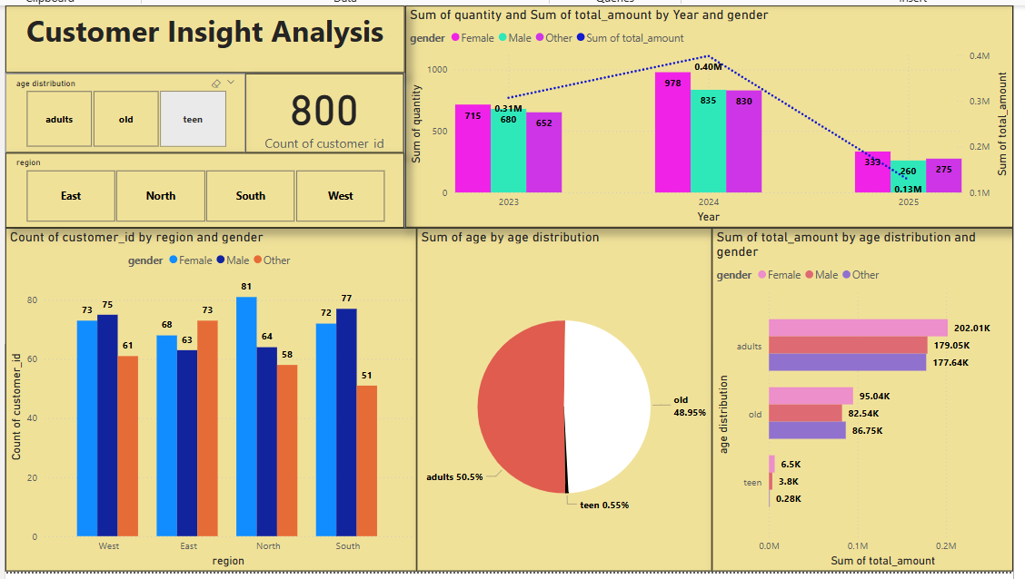
Customer Insight Analysis

Slide 3
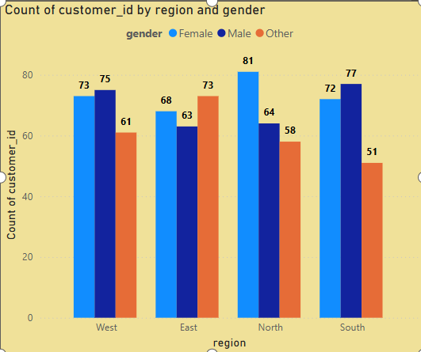
Customer Distribution by Region and Gender: North has highest number of female customers (81), making it the top-performing region for that demographic, The lowest count is observed for the "Other" gender in the South region (51).

Slide 4
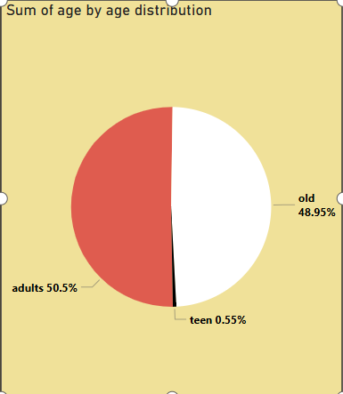
Customer Distribution by Age Group: Adults make up the largest share of the customer base, accounting for 50.5% of the total, The Teen segment is significantly underrepresented, with0.55% of the total customer population

Slide 5
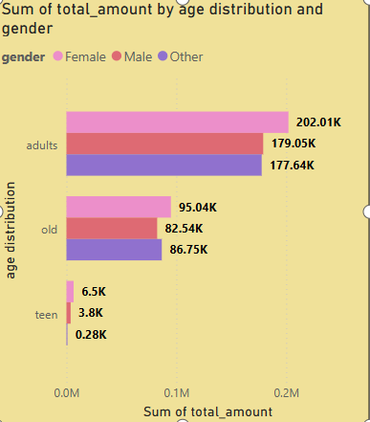
Total Purchase Amount by Age Group and Gender: Adults are the highest contributors Female adults: ₹202.01K, Males adults: ₹179.05K, Others ₹177.64K, Teen group contributes the least to revenue:Females: ₹6.5K, Males: ₹3.8K, Other gender: ₹0.28K

Slide 6
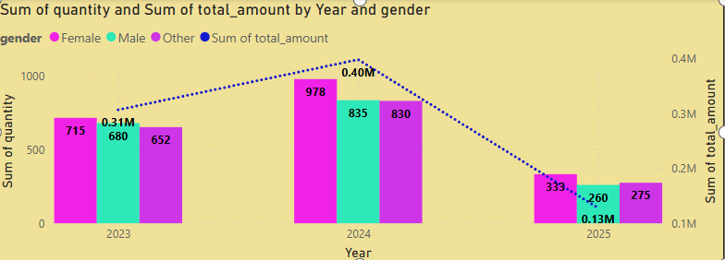
Yearly Sales Quantity and Revenue Trend by Gender: 2024 was the peak year in total revenue, In Quantity: Female (978), Male (835), Other (830),Revenue: ₹0.40M, 2025 shows a significant declined ln Quantity: Female (333), Male (260), Other (275),Revenue: ₹0.13M.

Slide 7
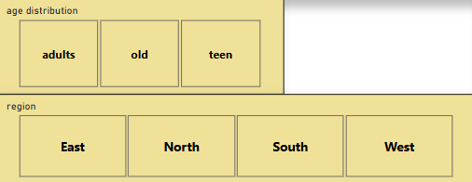
Customer Segmentation by Age and Region: This interactive dashboard segments customers based on two primary dimensions: age group and geographic region. It enables quick filtering and analysis of customer data to support data-driven decisions in marketing, sales, and customer service.

Slide 8
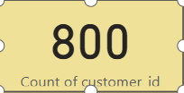
Number Of Customers in the Table

Slide 9
Conclusion
The Customer Insight Analysis dashboard provides a comprehensive overview of customer demographics, regional distribution, and purchasing behavior over time. The key insights are:
Customer Count & Distribution:
A total of 800 customers are analyzed.
The customer base is fairly evenly split between adults (50.5%) and old (48.95%), while teens represent a very small portion (0.55%).
Gender and Regional Breakdown:
Gender distribution across regions shows relatively balanced male and female representation, with slight variances by region.
South and North regions have the highest concentration of customers, especially among males.
Sales Trends Over Time:
2024 saw the highest performance in both quantity sold and total sales amount.
A notable drop in sales occurred in 2025, which may indicate a decline in demand or customer engagement that requires further investigation.
Age and Spending Behavior:
Adults generated the highest revenue across all genders, with Female adults contributing the most.
Old age group also had substantial sales, though slightly less than adults.
Teenage customers contributed the least to total sales, indicating limited engagement or purchasing power.

